Slide 1
Audio to Image with Pix2Pix
BY MICHAEL URLACHER

Slide 2
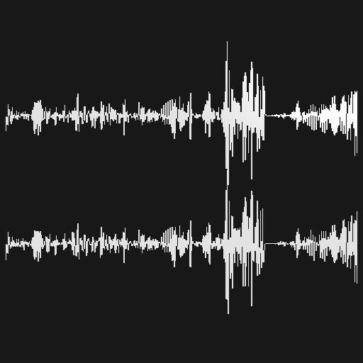
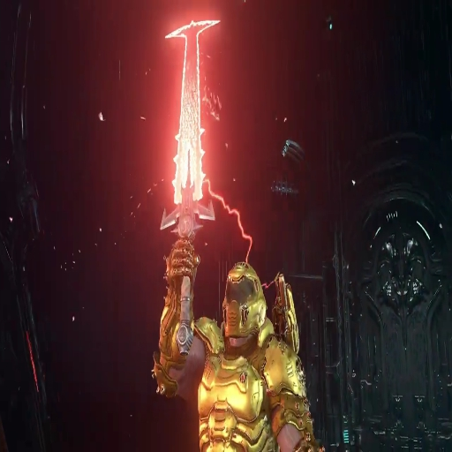
INSPIRATION, IDEA AND VISION
My inspiration was a YouTube video about creating images from a famous music video.
I used it to create my first ideas, but...
My final vision for my project was to use the actual sound, instead of lyrics.

Slide 3
WHAT DID I USE?
For this project I mainly used the Pix2Pix model and the program Touchdesigner.
For Pix2Pix I used the Pytorch version. With TouchDesigner I created my own Dataset and the use of the model.
Spout-Library provided by Vasily. Necessary for the use of the model with Touchdesigner.
CUDA Toolkit is also necessary in order to use the model.

Slide 4
DEMO

